Slide 1
Planning a Course of Study (and making progress through your program)
EDC&I 505 Masters Orientation
Nov. 7, 2011

Slide 2
What Courses Are Offered, and When
Look over potential courses (UW Course Descriptions), actual scheduled course listings (UW Time Schedule) (Winter 2012 is now available!)
CoE will have a new online course schedule available this Autumn – will let you see all courses scheduled for 2011-12 (and eventually for 2012-13)
Past years’ offerings may give a clue to future offerings (see Time Schedule Archive)

Slide 3
Getting More Information on Courses
Ask around:
your adviser (for contacts in the College, around the UW)
the instructor
the Area, Departmental secretary, administrator
other students (especially those who’ve been here longer than you have)
Look for information on faculty or course websites
Not all courses have these
Not all will be open/accessible

Slide 4
Should I Take This Course?
Sit in on first session, get the syllabus
It’s OK to “shop around”!
Figure out time demands of course in light of your other commitments that quarter
Do the course topic and assignments match your direction? Will they “move you along”?
Pay attention to UW rules on dropping/adding courses (and related financial issues)

Slide 5
What If I Don’t Like the Course?
Drop before the deadline!
Make sure you are in good standing (assignments, etc.) before you drop
If any question, talk with the instructor
Don’t assume that by dropping, you make everything “go away”

Slide 6
How Much Flexibility Do I Have?
A good deal (but it needs to be worked out with your adviser)
Some programs have more required courses
Instructor expectations vary
If you feel you have a problem
Talk with OSS staff
Talk with the Area Chair

Slide 7
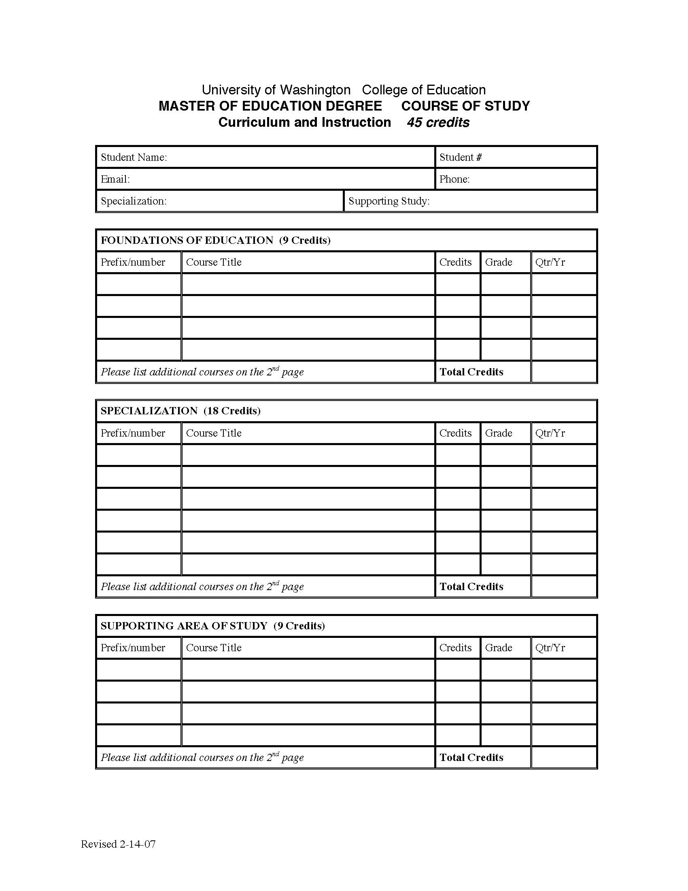
Where Do I List That Course?
On the Course of Study form…
While history, philosophy,
curriculum design, and
human learning are all
appropriate as “foundations”
courses, they’re not the only
options – consult with your
adviser!
Virtually all of “what courses go
where” is negotiable between you
and your adviser

Slide 8
The College and the University
Study options may require different amounts of work within and outside the College of Ed
E.g., Multicultural Ed – 12 cr. from wider UW
Even if your study option does not require it, explore outside-the-College course possibilities with your adviser
Getting access to non-CoE courses may require extra effort
Be aware how new UW budget rules interact with your choices

Slide 9
Complexities
Incompletes (Do you need to take one?)
Explain the situation to your instructor
An “X” [No Grade Now] is better than an “Inc” [Incomplete] – “Inc” stays on your transcript
Try to make them up soon! (In 1-2 months)
CR/NC and S/NS courses
Make sure you know what’s required to get “CR/S”
Per-course credit limits – “Wildcard” courses
Example: EDC&I 505 –15 credits max. in all courses with that course prefix! (We’re working on it…)

Slide 10
Maintain Forward Momentum
Satisfactory Progress (see CoE Grad Student Manual)
General academic expectations
Stay enrolled; watch incompletes, withdrawals
Stay in touch with your adviser
Keep your GPA above 3.0
If you’re on Probation with the Grad School
You will be notified
Follow all steps indicated (in the letter you’ll receive) to get off probation

Slide 11
Just in Case…
When students and instructors don’t agree…
There are “Grievance Procedures” for both the College of Ed and the UW Grad School
Not something to do lightly, but know that those procedures are available if you should need them
Other UW offices and services
Ombudsman
Disability Resources for Students
Q Center
Counseling Center
Student Conduct Code

Slide 12
Final Considerations: Course of Study
How will this course support your current work or shape your future work?
How will this course lead you towards a new position or responsibility?
How will this course help you complete your MEd, or get you ready to apply for a PhD or EdD?

Slide 13
For Our Next Meeting (Dec. 5)
Preparing a Project/Thesis
(Or getting ready for the exam)
Brief description of 1-3 possibilities (3 pp. maximum)
Options that would be interesting (and professionally useful) to you
Submit via Catalyst and bring to class
Think experimentally! This is something you can change or completely abandon as you move forward!

Slide 14
Questions?
See you on Dec. 5
Use the Catalyst GoPost for additional comments, questions
Thanks!

